Slide 1
Order Fulfillment
E-Commerce SE-413
Week 11
Notes:
1
1

Slide 2
Order Fulfillment
To deliver the right product, to the right customer in a timely, cost-effective and profitable manner.
Considered Backbone of an E-Commerce Business.
Critical but complex
Traditional vs EC
Small number of deliveries need to be made to multiple locations.
Dropship?

Slide 3
Order Fulfillment
Amazon
Started as a 0 inventory store (many sources, many destinations)
Proved Inefficient
Tried bypassing by using only 2 largest distributors.
Switched to Self handling soon.
Use Sorting Centers to simply things

Slide 4
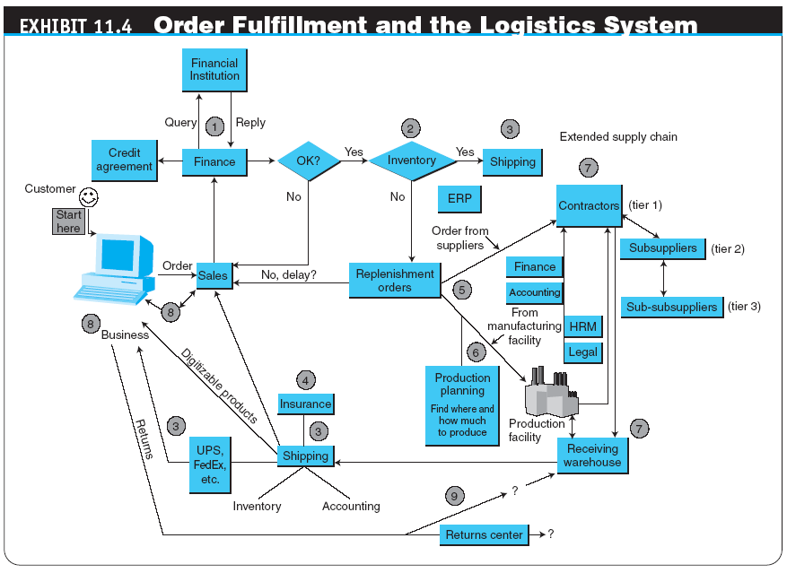
Order Fulfillment

Slide 5
Operation Models
Engineer-to-Order
Make-to-Order
Assemble-to-Order
Make-to-Stock
Digital Copy

Slide 6
Mass Customization and MTO/ATO
Mass production enabled companies to reduce the price per unit. Customization increases the cost.
How to keep additional cost low?
Mass Customization: Limited options, mass built/assembled.
Only order components required to fulfill customer orders.
Keeps the in-house inventory low.
Segmented Supply Chain:
Inventory volume according to type of segment
Example: Online, InStore, Business and Stock

Slide 7
Typical Problems in Fulfillment
Order Expectation
Quality of Fulfillment
Order Accuracy
Quality of Order itself
Order Management
Multichannel order Management
Distribution
Small number of items per order
Large number of orders
Variation in partner selection based on order
Number of stops in delivery
Delays
Cost

Slide 8
Major Causes of Problems
Inadequate Logistical Infrastructure
External Logistics Partners are always expensive.
Uncertainty in Demand
Demand forecasting can only predict partially.
Too many variables.
Poor information flow
Lack of efficient use of IT & Standards/Processes.
Cash flow
Credit Account, Borrowing, Late to Market

Slide 9
Solution: Hub Based Structure

Slide 10
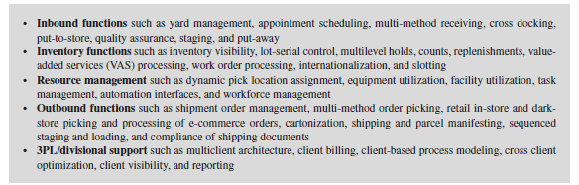
Solution: Warehouse Management System
A software that helps managing warehouses.
Searching and Organizing
Reduce OOS incidents.

Slide 11
Solution: SC Segmentation
Assign SC bandwidth based on demand and speed.

Slide 12
Reverse Logistics
Important but often not properly implemented.
Businesses can close if Return rate / cost is high.
Typical Routes
Ship product back to Seller’s Warehouse
Seller Arranges ad-hoc Pickup from Customer.
Improvements
Ship to nearest store.
Ship to nearest collection point / partner.
Use logistics and outsource delivery & returns.
Outsource returns to cost-effective specialist businesses.
Alternative
Partial or full refund if cost of return is high.

Slide 13
Innovation: Merge-In Transport
Applicable to MTA or DIY products with separate components.
Can be used to initiate customer delivery from regional distribution center.
Parts are shipped separately by manufacturer(s).
Arrive at Last Mile stop and Assembled/Combined.
Delivered in a single dispatch.

Slide 14
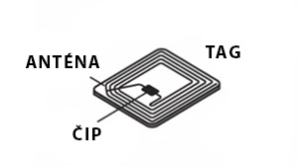
Innovation: RFID and Robots
RFID
Wireless ID Mechanism
Store data on a chip
Active or Passive
Massively improves processes that include item tracking.
Robots/Drones
Automate manually part of the processes.
Efficient and fast.

